Slide 1
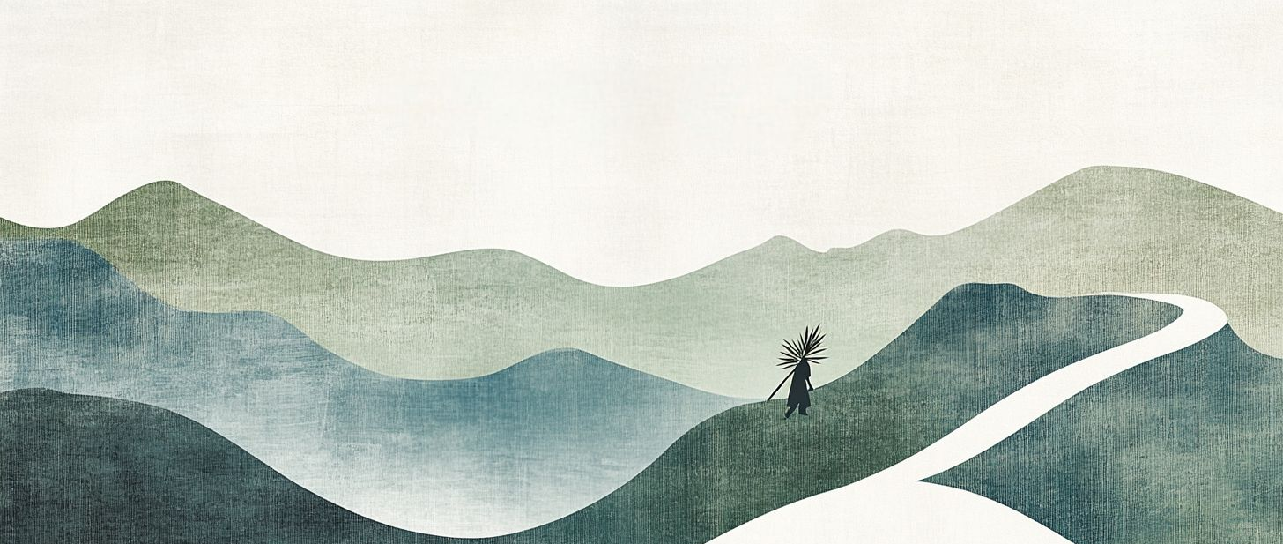
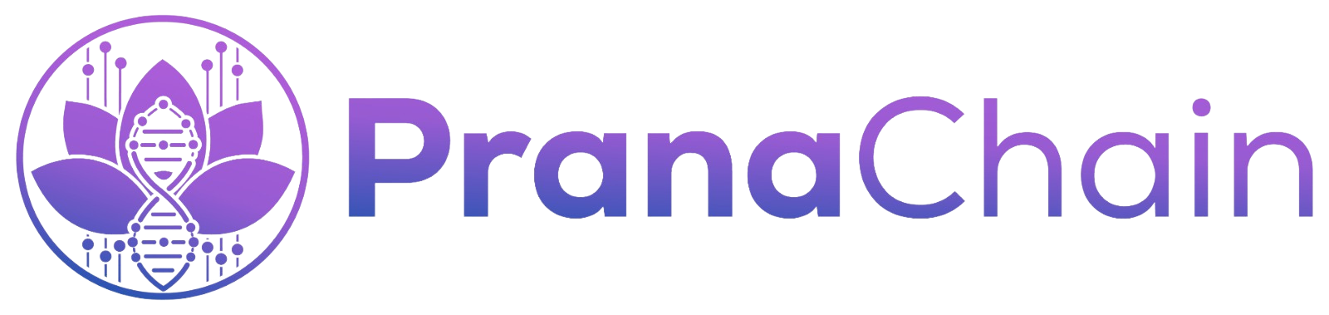

“The Next Era of Secure Predictive Healthcare.”
- A Pitch for

Slide 2

CONTENTS
01
02
03
Team & Vision
Problem
Solution

Slide 3

01
Team & Vision

Slide 4
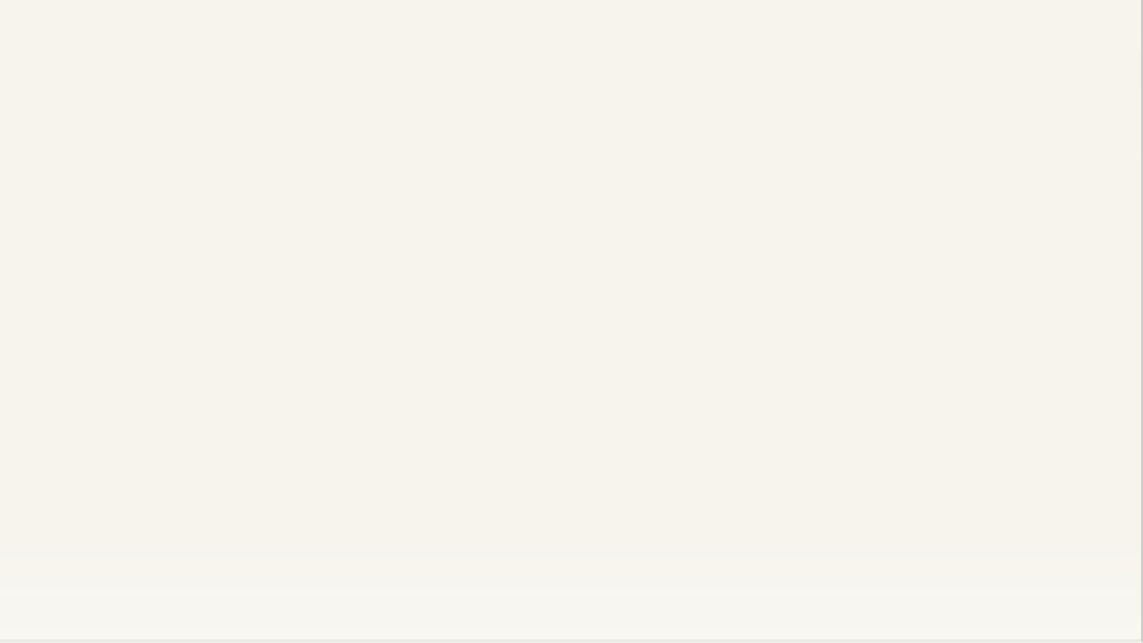
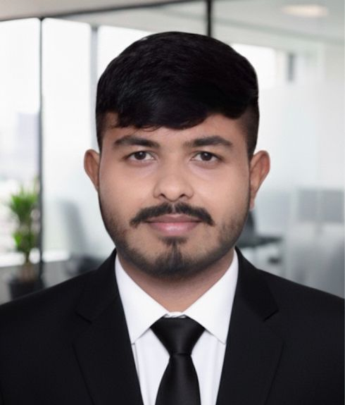
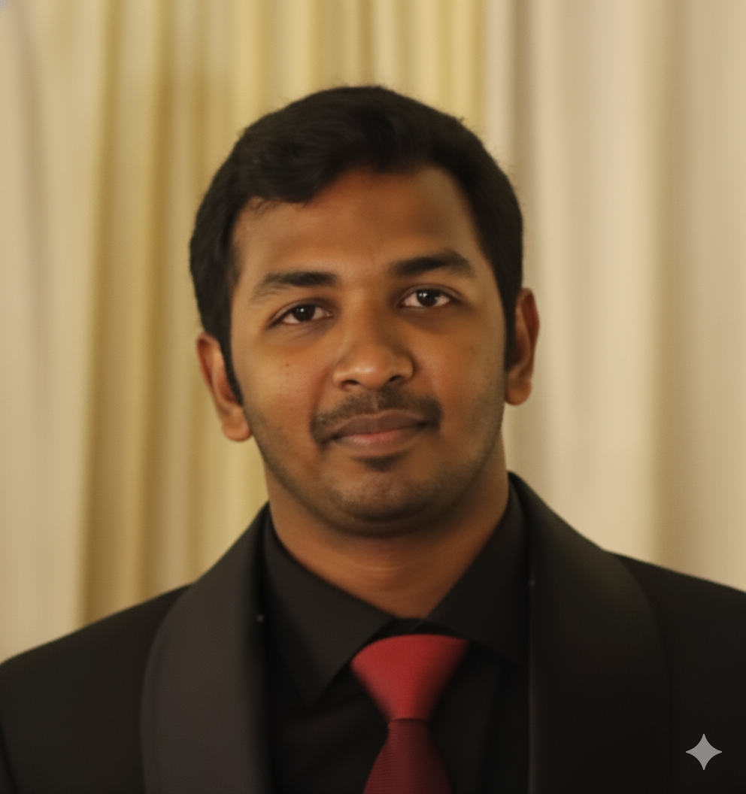
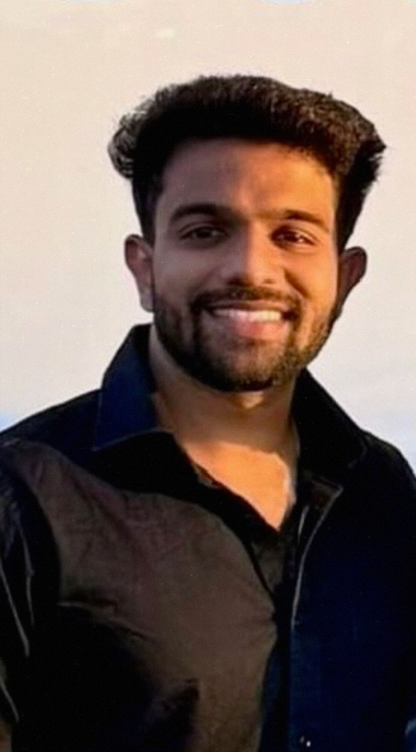
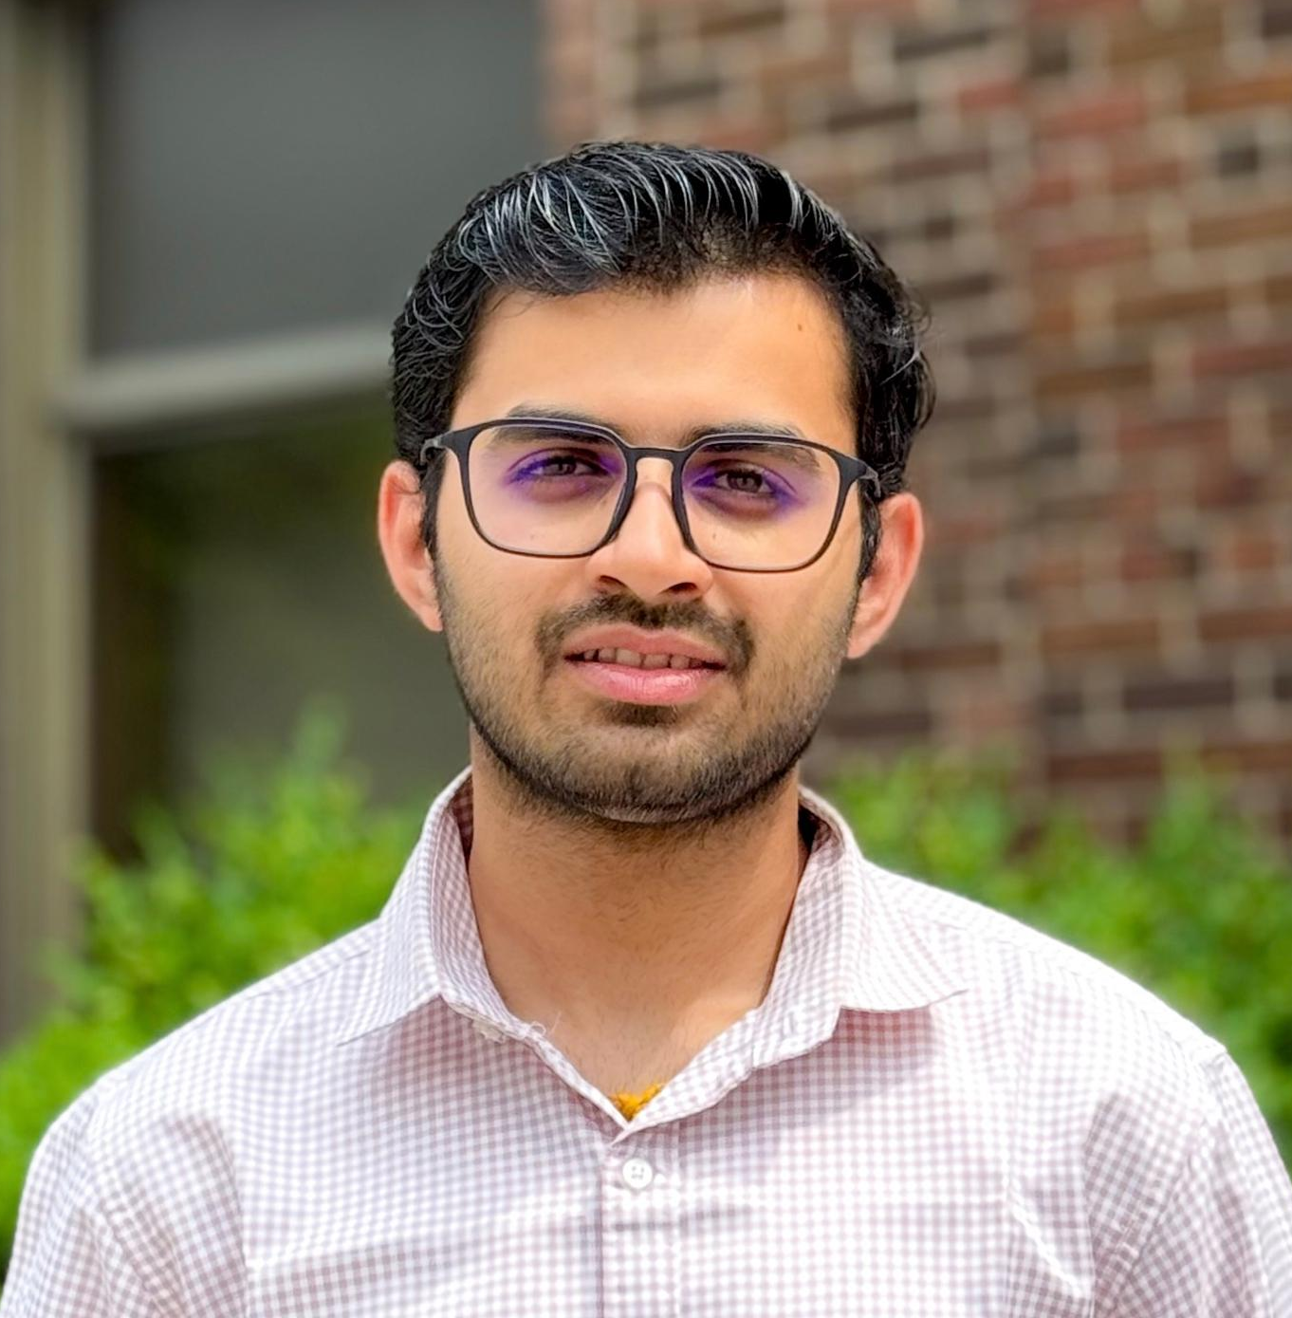
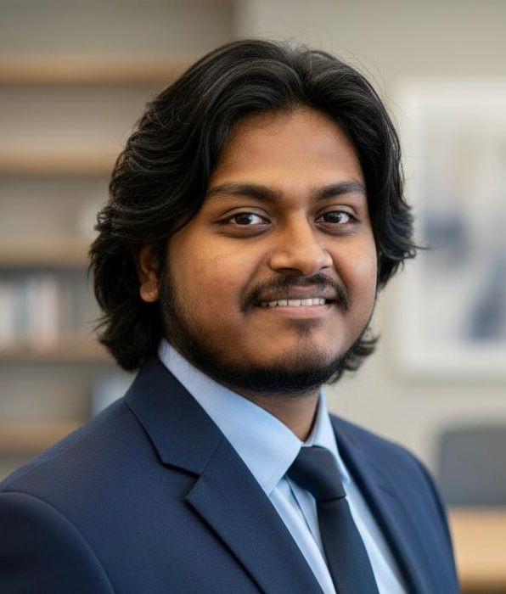
Team R.O.B.O.T.S - Group 16
|
Shaurya Parshad
(110191553)
ML Engineer & SDE
UI design, Backend development, CKD prediction model
Rithish Ashwin Suresh Kumar
(110182109)
Team Lead & Blockchain Architect
Blockchain security, Agile management, Backend integration
Timothy Eric Dare
Sandeep Kapoor
Ayeshkant Mallick
(110191780)
(110184820)
(110190414)
ML Engineer & Data Scientist
ML Engineer & Data Scientist
ML Engineer & Algorithm Specialist

Slide 5
02
Problem

Slide 6
The $500 Billion Crisis
💔 Imagine This... Every 5 seconds, someone dies from a preventable chronic disease.
Why? Three Critical Gaps:
450M
Overwhelmed Doctors
15 minutes per patient isn't enough for thorough analysis.
People Affected Worldwide
Confusing Blood Reports
$500B+
Patients don't understand their own health data, leading to inaction.
Spent Annually on Late Treatment
No AI Explainability
Doctors don't trust 'black box' predictions for critical health decisions.
50-60%
The Question: "What if we could detect these diseases YEARS earlier... automatically... with AI that doctors actually trust?"
Cases Could Be Detected Early

Slide 7
03
Solution

Slide 8
Meet PranaChain: The AI Doctor That Never Sleeps
A blockchain-secured, AI-powered platform analyzing blood reports to predict deadly diseases with doctor-trusted explainability.
How It Works
Triple-Disease AI
Blockchain Security
Blood Report Upload
CKD: 94%+ accuracy
Diabetes: 92%+ accuracy
Heart Disease: 90%+ accuracy
Results in 30 seconds
Patient owns their data on an immutable ledger. Doctors need permission, ensuring privacy and tamper-proof records.
OCR Data Extraction
3 AI Models Run Simultaneously
Smart Dashboards
SHAP Explainability
SHAP Explains the 'Why'
Patients track risk; doctors review predictions with SHAP charts and add clinical notes.
Shows exactly which blood values caused the prediction, building trust with visual waterfall charts.
Blockchain Secures Data
Doctor Reviews & Acts

Slide 9

THANK YOU !
Checkout our GitHub!
github.com/ayeshmallick/PranaChain
Nov 19, 2025

